Slide 1

IS204
System Analysis and Design
System Analysis Activities
Modelling
COMPUTER INFORMATION SYSTEM DEPARTMENT ASS.LEC. ZAINAB H. ALFAYEZ

Slide 2
Entity Modelling
Emphasis on data storage requirements for a new system and use the term data entities for the things about which the system needs to store information.
Data storage requirements include the data entities, their attributes, and the relationships.
A model commonly used by traditional analysts and database analysts is called the entity-relationship diagram (ERD).
COMPUTER INFORMATION SYSTEM DEPARTMENT ASS.LEC. ZAINAB H. ALFAYEZ

Slide 3
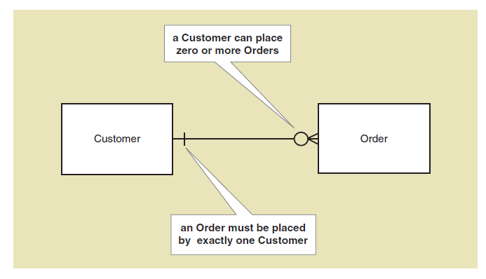
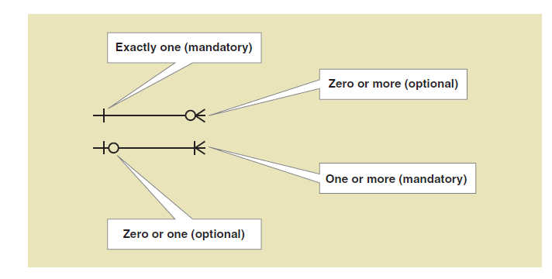
Entity-Relationship diagram (ERD)
COMPUTER INFORMATION SYSTEM DEPARTMENT ASS.LEC. ZAINAB H. ALFAYEZ

Slide 4
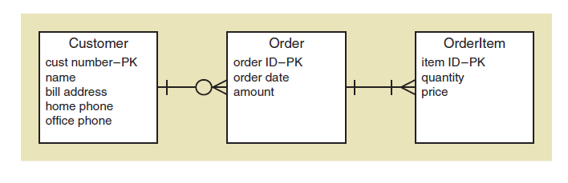
Entity-Relationship diagram (ERD)
COMPUTER INFORMATION SYSTEM DEPARTMENT ASS.LEC. ZAINAB H. ALFAYEZ

